Slide 1
Boost.Atomic & Boost.LockFree
Presenter: Syed Muhammad Saim Subject: Distributed System

Slide 2
Contents
Boost.Atomic
Basic Commands
Increment Using boost::atomic
Lock-free
Sequential Consistency
Relaxed
Release & Acquire
Boost.Lockfree
Single Producer / Single Consumer
Capacity
Queue with variable container size
Queue with constant container size
References

Slide 3
Boost.Atomic
Library that provides atomic data types
Atomic variables
Use: coordinating multiple threads and faster alternatives
Processor-specific instructions
Implements the interface of C++11
Provides the class boost::atomic

Slide 4

IMPLEMENTATION

Slide 5
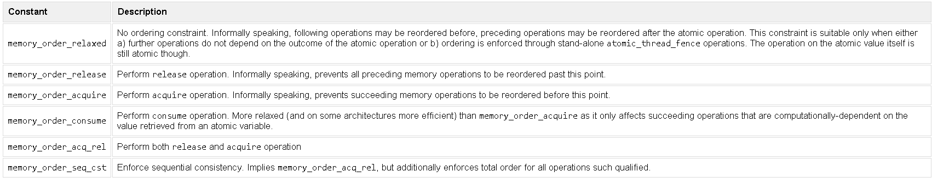
Basic Commands

Slide 6
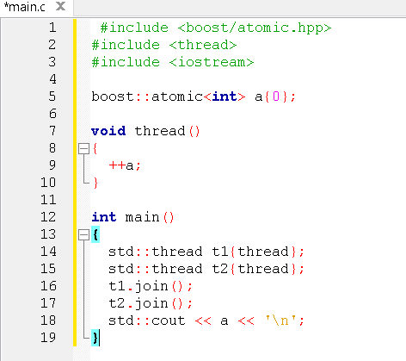
Increment Using boost::atomic

Slide 7
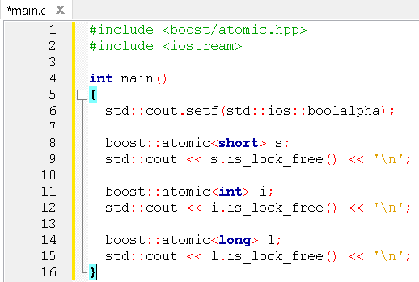
Lock

Slide 8
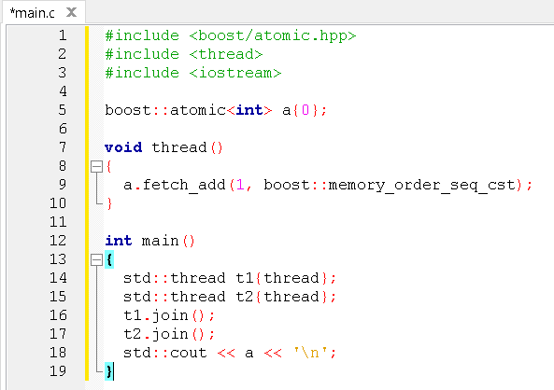
Sequential Consistency

Slide 9
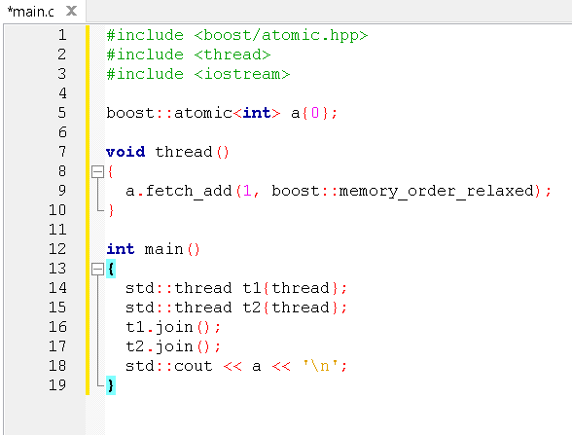
Relaxed

Slide 10
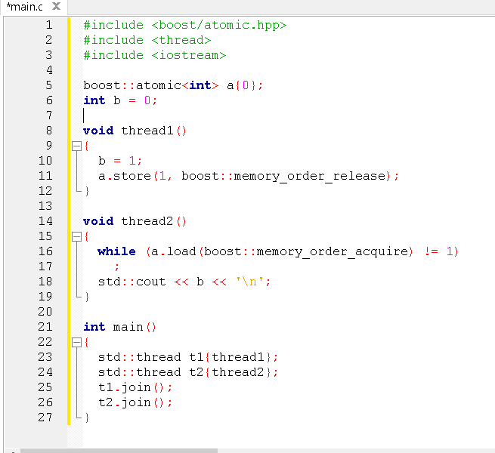
Release and Aquire

Slide 11
Atomic Objects
boost::atomic<T> template class
boost::atomic<integral> template class
boost::atomic<pointer> template class

Slide 12
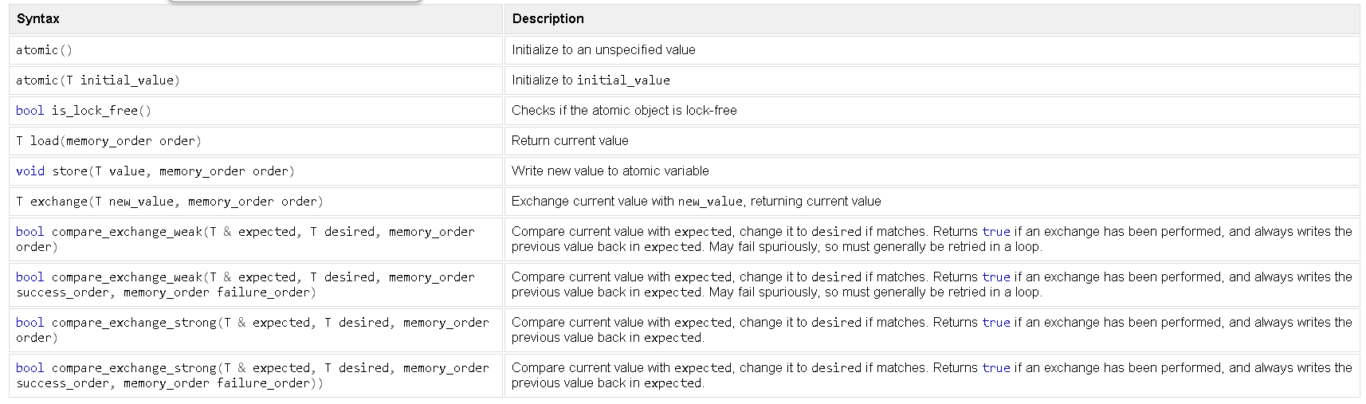
boost::atomic<T>

Slide 13
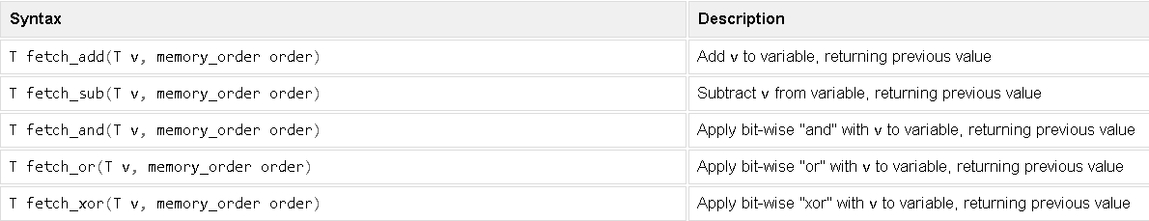
boost::atomic<integral>

Slide 14
boost::atomic<pointer>

Slide 15
Fences

Slide 16
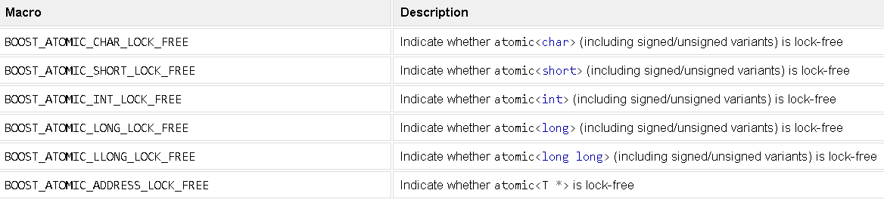
MACROS

Slide 17
Boost.LockFree
Thread-safe and Lock-free containers
Provides the class boost::lockfree

Slide 18
Basic Commands
boost::lockfree::queue boost::lockfree::stack
boost::lockfree::spsc_queue
boost::lockfree::fixed_size boost::lockfree::capacity boost::lockfree::allocator

Slide 19
Implementation

Slide 20
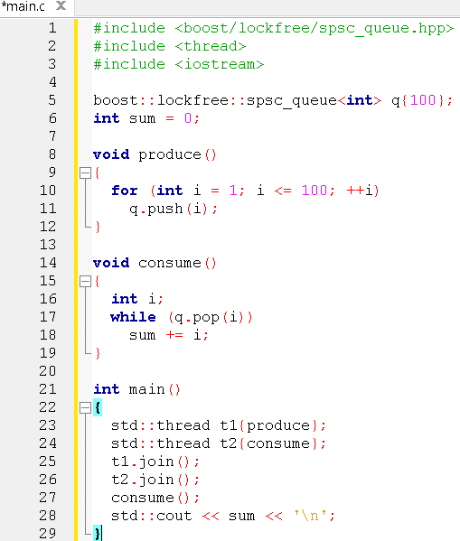
Single producer / Single consumer

Slide 21
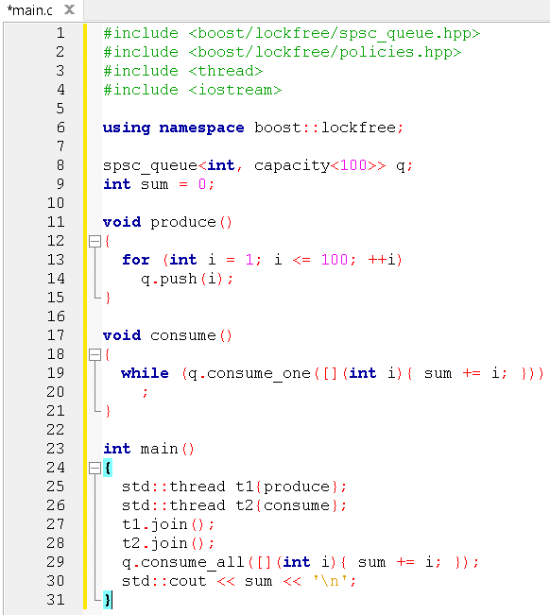
Capacity

Slide 22
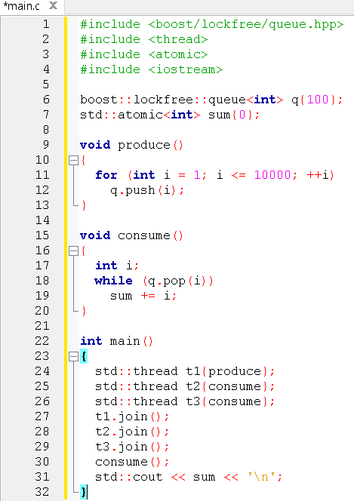
Queue with variable container size

Slide 23
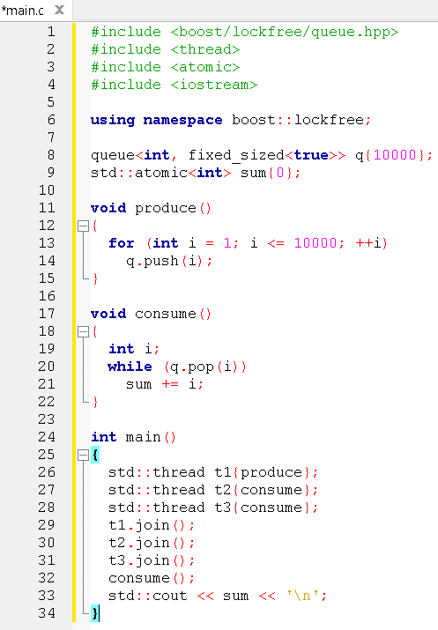
Queue with constant container size

Slide 24
References
https://www.boost.org/doc/libs/1_54_0/doc/html/
https://www.cplusplus.com/reference/atomic/atomic/atomic/
https://theboostcpplibraries.com/boost.atomic
https://theboostcpplibraries.com/boost.lockfree
https://en.cppreference.com/w/cpp/atomic/atomic/fetch_add

